Slide 1
EFFECTS Of Social Media ON Mental Health
PRESENTED BY
BASIRAT ESAN
FE/23/8059291
FINAL PROJEECT PRESENTSTION FOR 3MTT COHORT 1

Slide 2
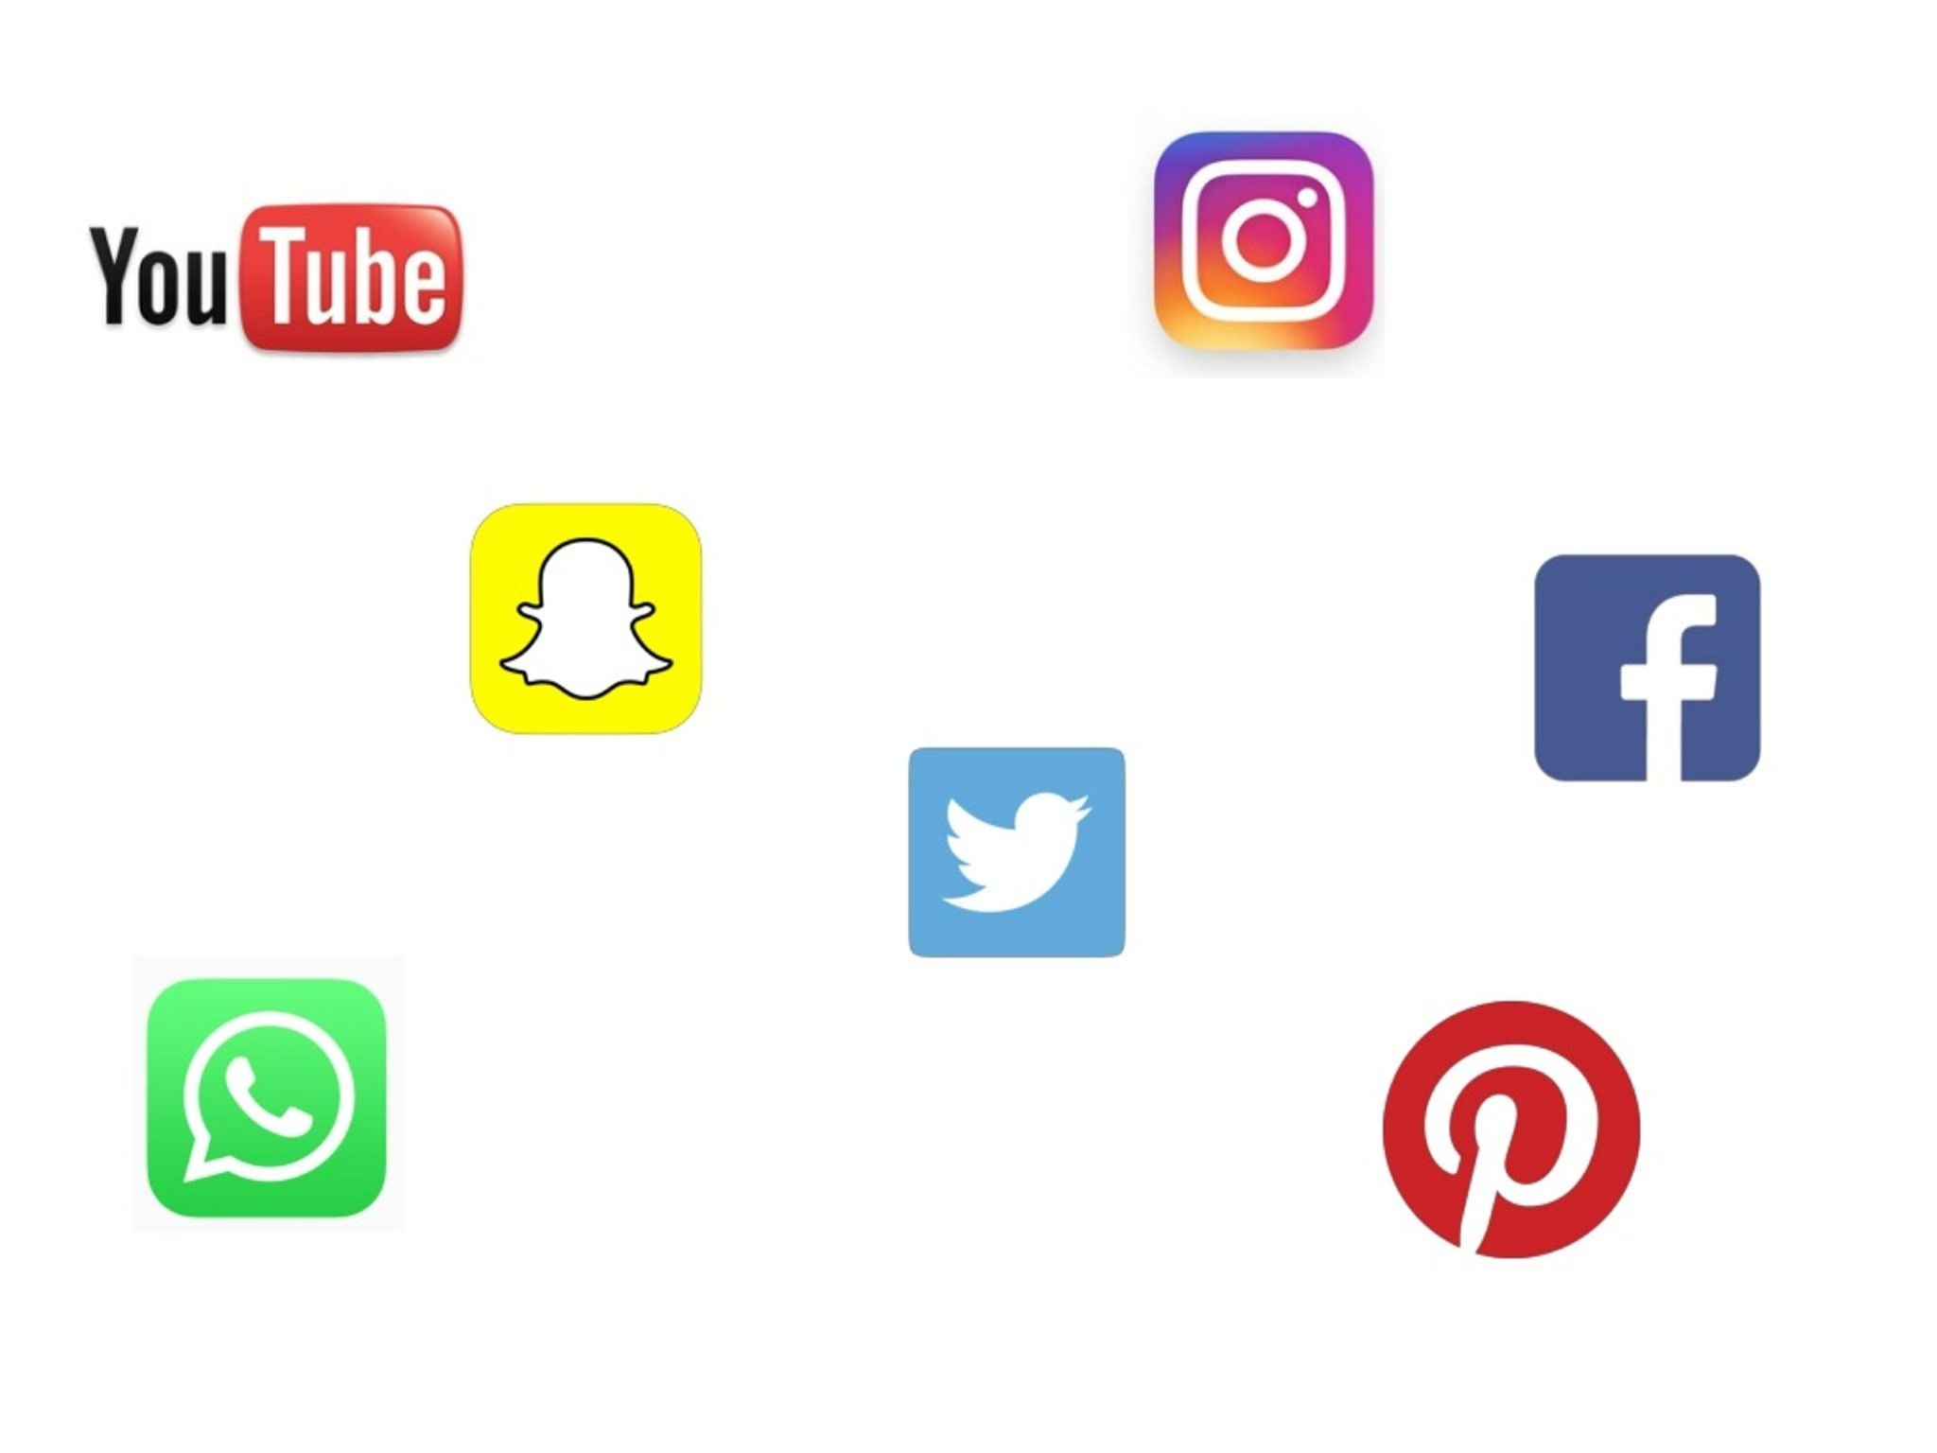
‘Social media is a form of electronic communication through which users create online communities to share information, ideas, personal messages and other contents’ (Merriam-Webster). 85% 0f 15-36 year olds have a profile on a social media or messaging site (Ofcom ,2023). Over half of these population size use smart phone on daily basis. Mental health is generally the ability to think, feel, and react in the ways that life needs to be lived(how you want to live and need to live). A poor mental health phase involves frequent thinking, feeling or having difficulties when reacting to situations positively.
INTRODUCTION

Slide 3


So many of us are obsessed with updating our social media accounts. We let people know what we are doing and where we are. What effect does all the online activity have on our mental health?
INTRODUCTION

Slide 4
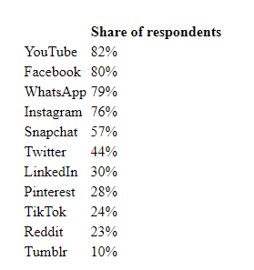

This presentation is aimed at investigating the potential correlation between social media usage and the impact it has on mental health.
AIMS AND OBJECTIVES

Slide 5
The data was secondarily sourced from kaggle.com. The data set contain age, gender, type of social media used by respondent and other variables. The data set used can be found in the link below https://docs.google.com/spreadsheets/d/1TsrSKPR-P_Y6u3rb4dksN9i5GCNH6llQ/edit?usp=sharing&ouid=104598922725296467906&rtpof=true&sd=true
DATA SET USED

Slide 6
The methodology involves conducting a survey to collect data, organizing the data, and using Microsoft excel techniques to create a predictive model that can determine whether a person should seek professional help based on their answers to the survey questions. The Data set were cleaned and exported using python Using charts for the visualization
METHODOLOGY

Slide 7
KEY QUESTIONS
Which gender Uses social media more and their relationship status?
How often do you find yourself using Social media without a specific purpose?
How often do you find distracted or depressed while using Social media?
NEGATIVE EFFECTS OF SOCISL MEDIA
Increased feelings of depression
Overthinking and Rumination
Anxiety
Poor Body Image
Loneliness
FoMO (Fear of Missing Out)
Poor Sleep Quality
Highly Addictive

Slide 8
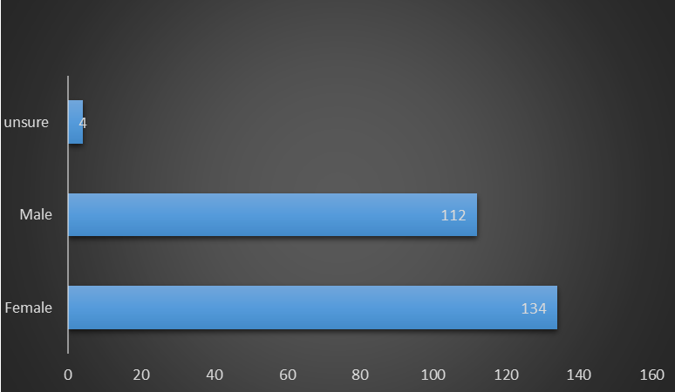
From the analysis it could be deduced that 134 of the total sample 250 are female and the male folk are 112 . making it obvious that the female gender use social media more.
FINDINGS AND INSIGHTS

Slide 9
From the charts above, it was found that the singles uses social media more than other relationship status. While the other chart indicates the hours spent on social media based on the occupational status of the respondents. The analysis showed the university students spends more hours on social media than the salary worker or retired worker. This can be true since the university students have more valid reasons for being on social media (assignments, networking, keeping in touch with folks at home).

Slide 10
How often do you find yourself using Social media without a specific purpose?
From the analysis it can be found that the female gender are easily distracted by social media and they spend more time on social media without specific purpose. They also very distracted by social media. This is true as the female folks mostly seek validation from their friends and peers more than the male folks

Slide 11
How often do you loose concentration, compare yourself to your celebrity idol while using Social media?
From the analysis it can be found that the most of the respondents easily compare themselves to their celebrity idol (given by the scale of 4 which has the highest response of 231) on social media. specific purpose. They also find it difficult to concentrate without social media. This validate the mentality of social media affecting the lives of its users which could be positive or negative.

Slide 12
How often do you feel restless if and loss sleep due to Social media usage?
From the analysis it can be found from the first pie chart that most of respondent feel restless if they haven’t used social media in a while (11 signifying 75% of the respondents). Also, 80% of the respondent lose sleep due to social media usage. This could adversely affect the mental health as the brain functionality could be deterred

Slide 13

Recommendations
From the findings of the analysis the following recommendations could be made:
Since Social media can be very addictive and not only affect sleep but even change the brains of social media users; user regulation should be enforced and fully implemented.
In addition social media can also often be used to deliberately make other people feel bad with online bullying. It is widely recognized that people are much more willing to be unpleasant to each other when anonymous behind a computer screen. Regulations should be in place to help deal with these whenever it occurs.
Social media can be a brilliant way to develop your creativity; stakeholders should use it to help boost the mental health of the users

Slide 14

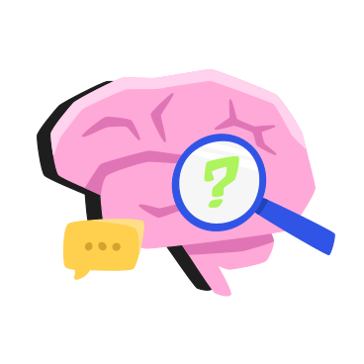
conclusion
In conclusion, Social media and mental health are correlated in multiple ways that we need to be conscious of. While social media can cause problems, there are some great benefits as well like increased creativity and networking which could help in various collaborative prospects.

Slide 15
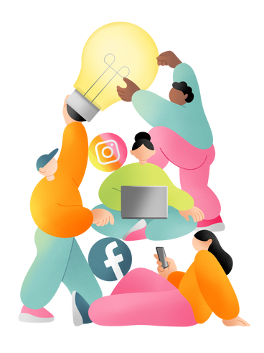
Thank you

